Slide 1
Slide 15
Object Oriented Programming
Dasar-Dasar Pemrograman 1
Semester Ganjil 2016/2017

Slide 2
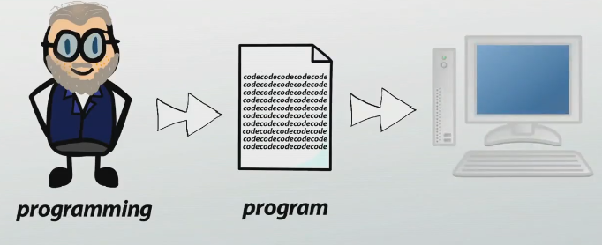
Programming
Programming is a creative process carried out by programmers to instruct computer on how to do a task. The result of programming is a program
Program is set of instruction to tell the computer what to do in order to come up with a solution to solve particular problem
Dasar-Dasar Pemrograman Ganjil 2016-2017

Slide 3


Programming
Junk electrical box with some high priced stuffs
+
Program
Programming
Dasar-Dasar Pemrograman Ganjil 2016-2017

Slide 4
Programming paradigm
Fundamentally different approaches to build solutions to specific types of problems using programming
Most programming language just fall under one paradigm, but some languages have elements of multiple paradigm
Two most important programming paradigm:
  Procedural paradigm
  Object oriented paradigm
Dasar-Dasar Pemrograman Ganjil 2016-2017

Slide 5
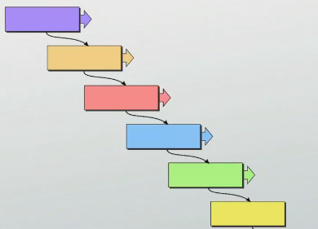
Procedural paradigm
List of instruction to tell the computer what to do step by step
Also known as top down languages
Code a
Code b
Code c
Code d
Code e
Code f
Dasar-Dasar Pemrograman Ganjil 2016-2017

Slide 6

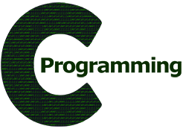

Procedural programming
Dasar-Dasar Pemrograman Ganjil 2016-2017

Slide 7
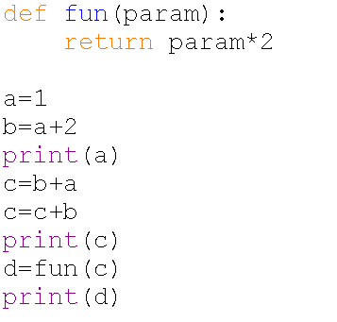
Example: procedural programming illustration
Dasar-Dasar Pemrograman Ganjil 2016-2017

Slide 8
Object Oriented Programming
Approach to problem solving where all computations are carried out using objects
In programming language, object is component of a program that knows how to perform certain actions and how to interact with other elements of the program
Object is an entity/unit which consists of data and behavior
Dasar-Dasar Pemrograman Ganjil 2016-2017

Slide 9
Object
An object has:
  Variable/property:
    “Something that object knows”
    The data of the object
  Method/behavior:
    “Something that object does”
    Method can describe what object can do
    Method also can be something that modify the object data
Dasar-Dasar Pemrograman Ganjil 2016-2017

Slide 10
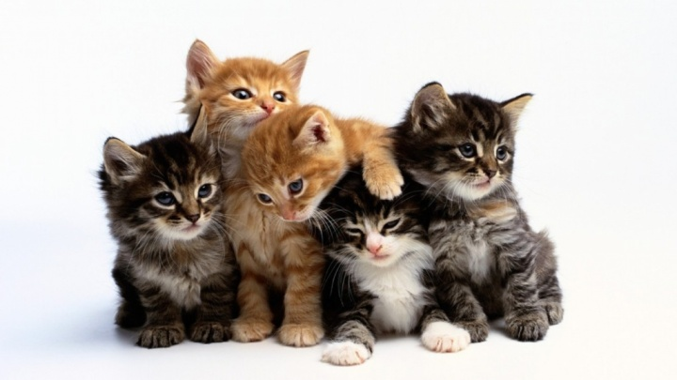
Example
A cat
  Variable/property:
    name
    race
    color
  Method/behavior:
    eat()
    sleep()
    chaseMouse()
    miaw()
Dasar-Dasar Pemrograman Ganjil 2016-2017

Slide 11
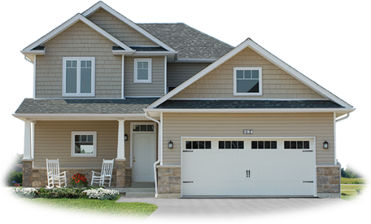
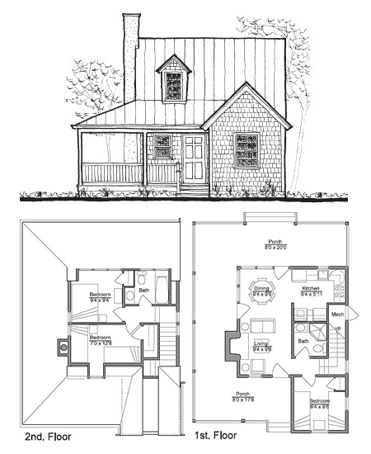
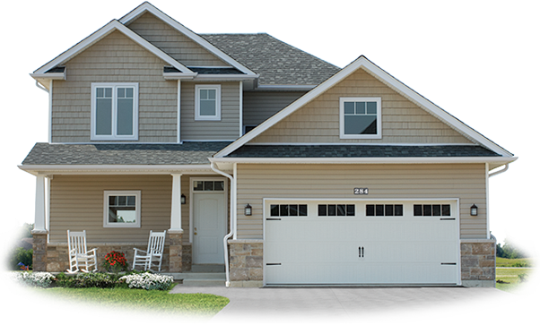
Class
Blueprint/Plan/Template of objects
Dasar-Dasar Pemrograman Ganjil 2016-2017

Slide 12
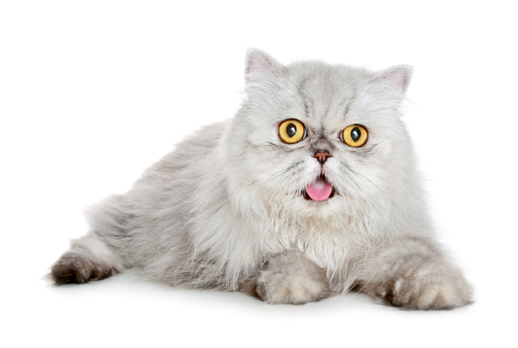
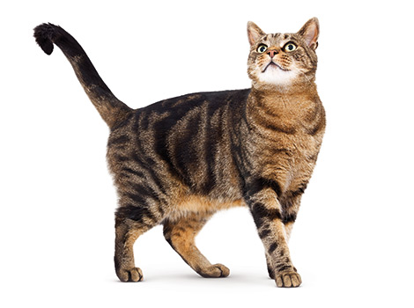
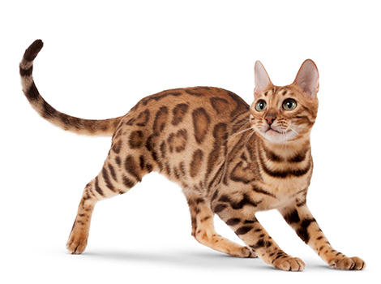
Class: where object belongs to
Objects which has same type  They must come from same class
Object is an instance of a class
Cat
name
race
color
eat()
sleep()
chaseMouse()
miaw()
Cat 1
Cat 2
Cat 3
Dasar-Dasar Pemrograman Ganjil 2016-2017

Slide 13
Class vs Object
Class | Object
Attribute descriptions of objects | Representation and instance of a clas
A concept | A fact
Logical existence | Physical existence
Memory space is not allocated when it is created | Memory space is not allocated when it is created
Definition is created once | It is created many time as you require
Example: Person | Example: Budi, Ani, Anto, Andi
Dasar-Dasar Pemrograman Ganjil 2016-2017

Slide 14
References
William Punch & Richard Enbody. The Practice of Computing using Python, 2nd Edition. Addison-Wesley, 2013
Y. Daniel Liang. Introduction to Programming Using Python. Prentice Hall, 2013.
John Zelle. Python Programming: An Introduction to Computer Science, 2nd Edition. Franklin, Beedle & Associates Inc., 2010.
Mark Lutz. Learning Python, 5th Edition. O’Reilly Media. Copyright 2013 Mark Lutz, 978-1-44-93-5573-9
L. Y. Stefanus. Slide Pelatihan Python. 2015.
Dasar-Dasar Pemrograman Ganjil 2016-2017

